Slide 1
1/10
An Implementation of Dawson Integral
Under the guidance of Prof. V. Milutinovic
Presenter - Jayendra Khandare
(jkhandar@umail.iu.edu)

Slide 2



2/10
Dawson Integral[1]
Given by function,
As it is an odd function, it can be given as,
For applying to the Complex plane, it can be modified as,
- where erfi(z) is error function and w(z) is Faddeeva function

Slide 3
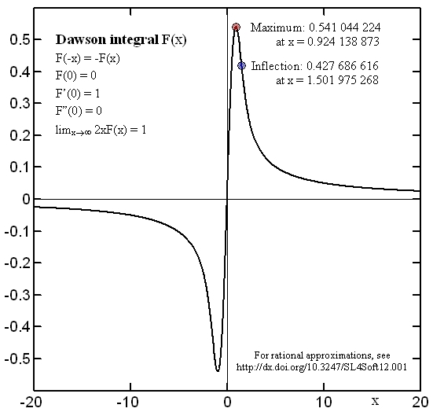
Dawson Integral Graphical Representation
3/10
From the graph for Dawson Integral, it can be said that this function can be taken as one sided Fourier – Laplace sine transform of the Gaussian function.[2]
Notes:
Incur an overhead/cost for this reconfigurability; but can make that back by efficient architecture (dataflow)

Slide 4

Implementation Details
4/10
This implementation is for Maxeler Systems and works on data-flow based model.
The base code was used from the book :
  “ Numerical Recipes in C ” [3]
The function can be summed up as :
                (eq.1)
When h is sufficiently small and n large enough,
speedup is possible.

Slide 5
Requirements for Acceleration
5/10
There are 6 requirements for a loop to be ported to data-flow model. [4]
The base C code has 2 loops.
Both of them can be accelerated since both are used
  Multiple times hence their level of re-usability is high.
  They contribute highly to the overall execution time.
The first factor in (eq.1) is accelerated in this implementation.
An outline is given for calculating the value of the third factor.
Second factor is not calculated using a loop,
hence it cannot be accelerated using data flow model.

Slide 6
How to run this Implementation
6/10
This implementation is created using WebIDE [5]
  provided by Maxeler Technologies.
It also uses ‘simpleKernel template’ which already exists in WebIDE account.
Simply copy the CPUcode and EngineCode into respective files.
Change the value of x in the CPUCode to the one you desire.
Delete all pre-existing .max configuration files[6] from :
  CPUCode/results
  RunRules/Simulation/maxfiles
Press ‘BUILD’ button which will compile the code and create graphs, and DFEs.
At the end, you will get the results as:
  the value of F(x) which is Dawson’s Integral for the float value (x) provided before
  the graphs created for this implementation

Slide 7
What actually happens
7/10
During one unit of time called a tick,
the Kernel executes a step of computation,
consumes one input value, and
produces one output value.
This is done after creating appropriate graphs.

Slide 8
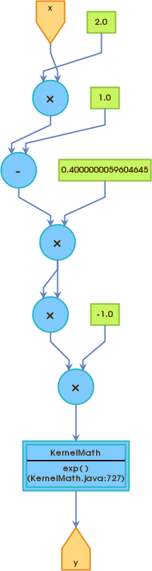
Graph created for LOOP 1
8/10

Slide 9
References
9/10
‘Dawson Integral’ information page maintained at
  https://en.wikipedia.org/wiki/Dawson_function
Graphical represenation of Dawson Integral given at
  http://www.ebyte.it/library/codesnippets/DawsonIntegralApproximations.html
‘Numerical Recipes in C’ - The art of Scientific Computing Second Edition
  by William H. Press, Saul A. Teukolsky, William T. Vetterling, and Brian P. Flannery
Instructions provided by Prof. V. Milutinovic for porting a loop into data-flow system.
  http://home.etf.rs/~vm/os/vlsi/predavanja/maxeler.html
WebIDE provided by Maxeler Technologies(available free to students)
  https://maxeler.mi.sanu.ac.rs/
A special thanks to Mr. Ognjen Andric for providing instructions to correct a bug found in WebIDE.
  oandric@maxeler.com

Slide 10
About Presenter
10/10
Jayendra Khandare
Graduate Student at School Of Informatics and Computing, Indiana University Bloomington
Created this implementation for :
  CSCI B649 DATAFLOW SUPERCOMPUTING
Course taken for 3 Credits
  under Prof. V. Milutinovic

